Slide 1
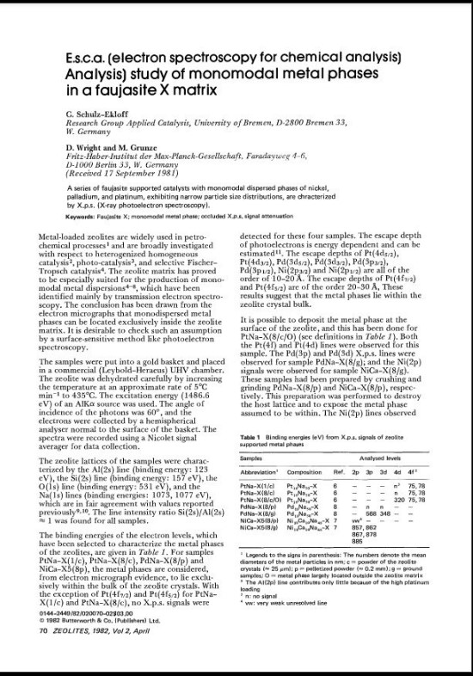
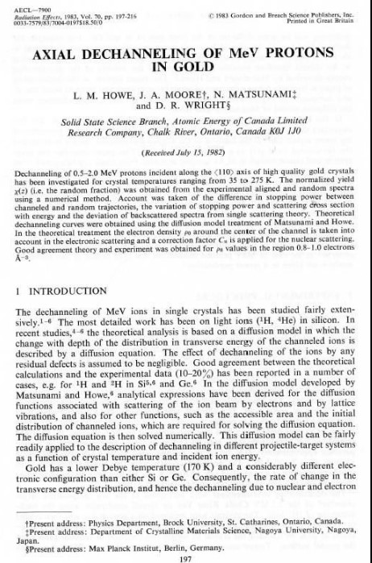
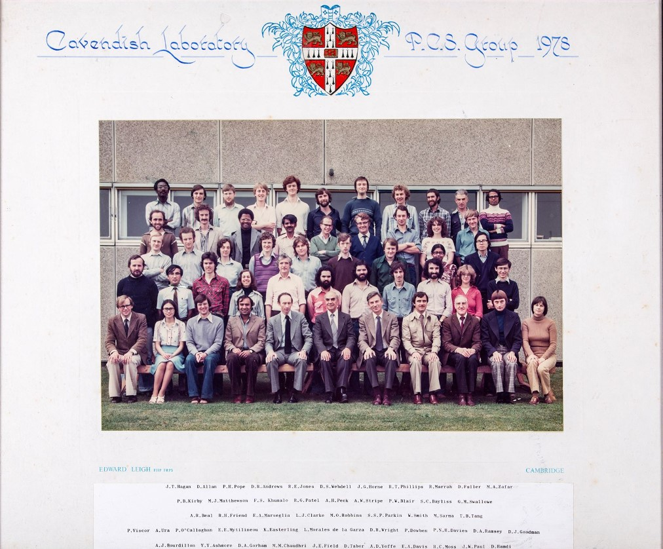
1 Introduction - my old life
Notes:
1 Introduction. My background is in scientific research, which can be perceived as very different from fine art, but there could be some overlaps. I’d like to use my photography and writing skills, maybe some others, to explore some themes in a fine art context.

Slide 2
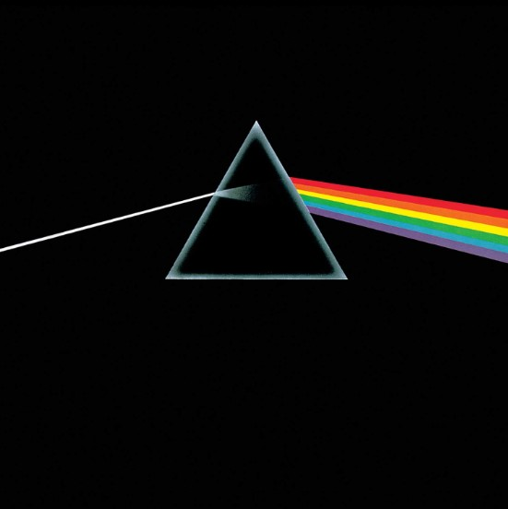
2. Possible Themes –Time and ...
I was very interested in the concept of time. I couldn’t get my head round Einstein’s interpretation in his relativity papers. I recall sitting in a park beside Wembley library, watching squirrels and wondering about how they would appear in a time frame travelling at 9/10ths of the speed of light, then going home and listening to Pink Floyd’s Time from ‘Dark Side of the Moon’ ,
“Ticking away the moments that make up a dull day,
You fritter and waste the hours in an offhand way”.
How do these fit together?
Notes:
2. Possible Themes. I have always been fascinated by the concept of TIME in its various aspects and would like to explore some of them. My work will use a ’found object’, an old wallet of mine, and visits to the beach, as examples.

Slide 3
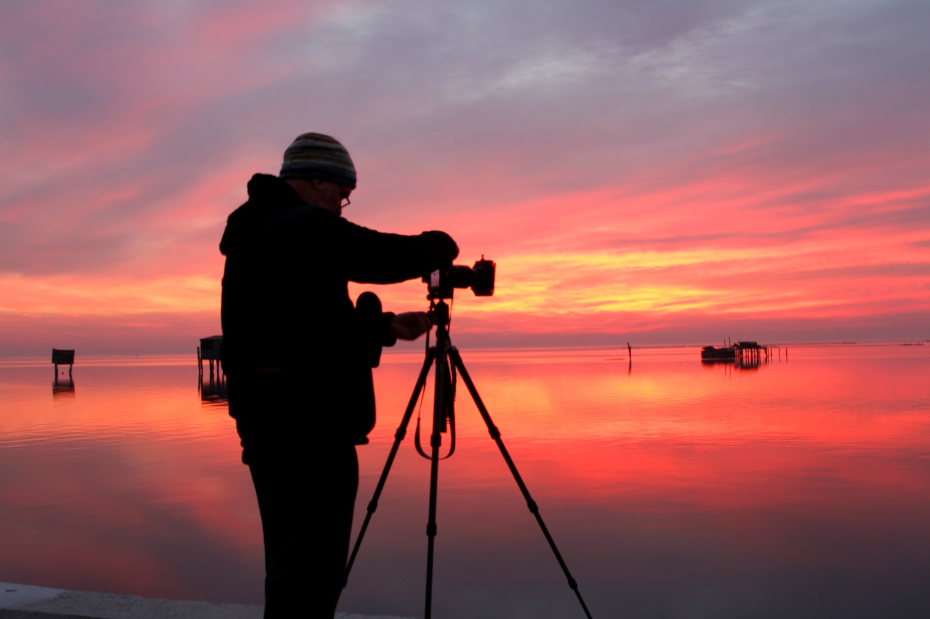
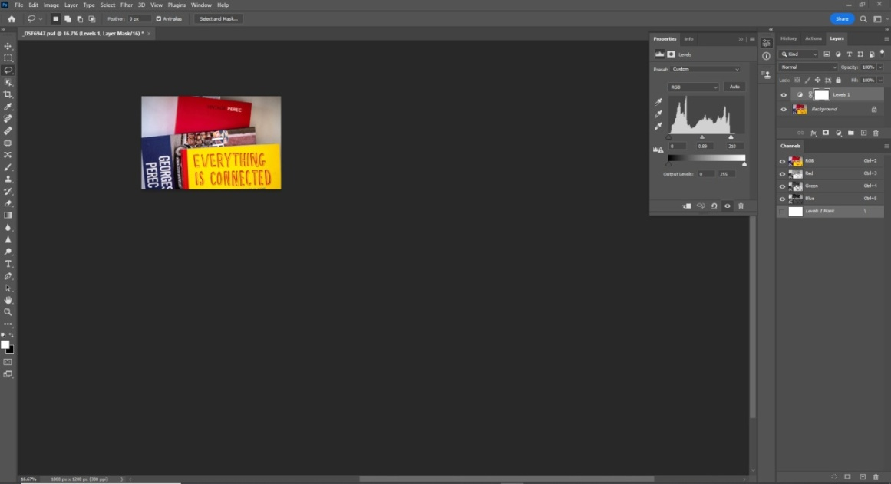
3. Practical Work
Notes:
3. Practical Work. Principally I use photography and photo-editing software to produce my images, then writing, possibly painting or ceramics, to portray the concepts in other ways.

Slide 4
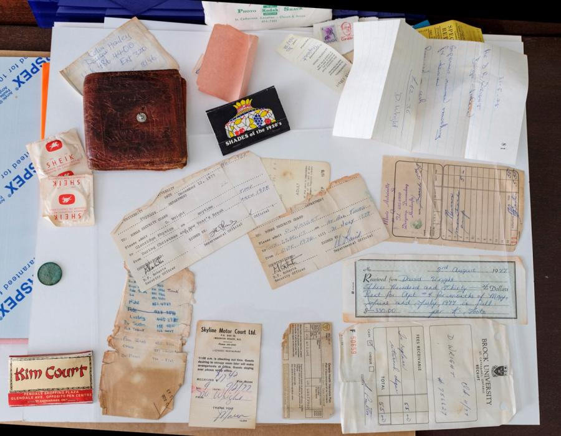
4. The Wallet, a ‘found object’
Notes:
4. The Wallet. An old wallet I found in a box in my roof space, contained objects from a particular time of my life in the mid-70s, when I was in Canada doing a MSc in Physics. Opening the wallet brought back many memories of that period.

Slide 5
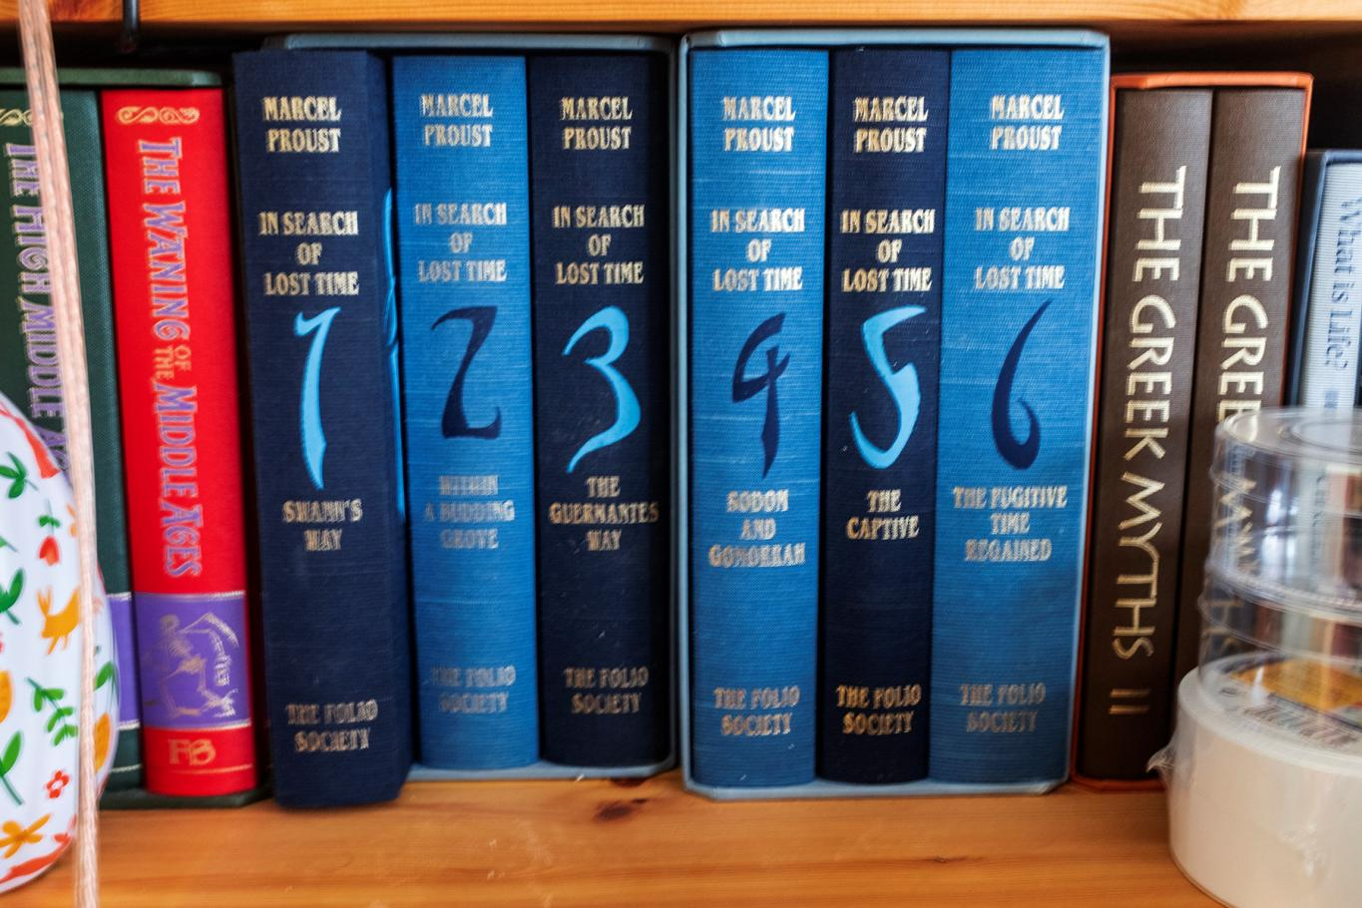
5. Proust, A la Recherche du Temps Perdu
Notes:
5. Proust. Recovering the wallet reminded me of the scene in Proust’s ‘ A la recherche du temps perdu’, where the taste of madelaines brought back vivid memories of a former time, place and events when the narrator had been given the same cake by an aunt.

Slide 6
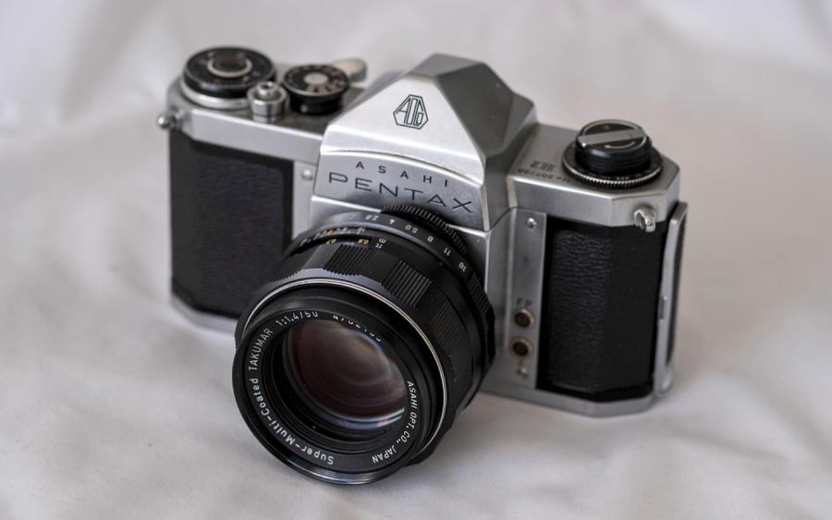
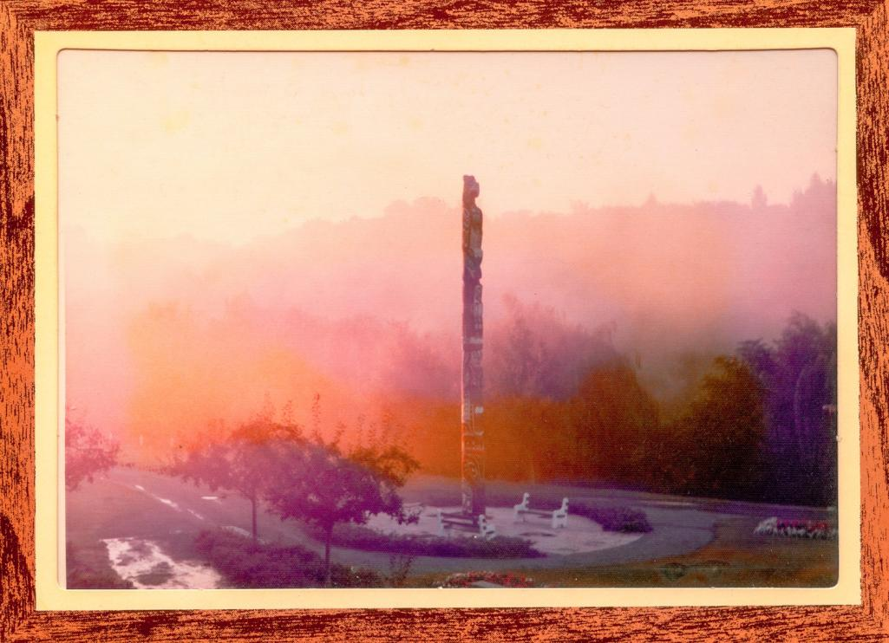
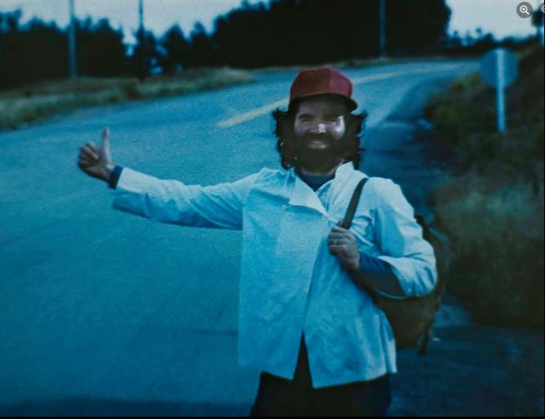
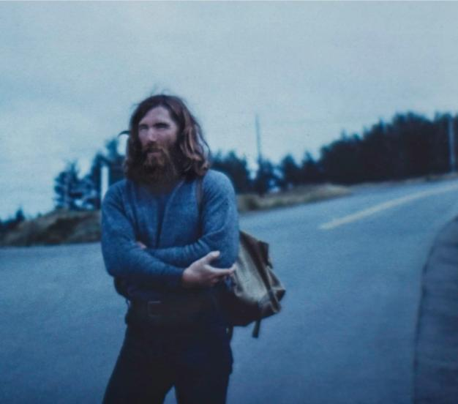
6. Pentax H2 camera
Notes:
6. Pentax H2 camera. I have an old camera, purchased at this time in Canada. It’s a very simple camera, from a simpler era, and I’ve some photos taken at that time with it. I intend to do more with this camera, including images of the found object.

Slide 7
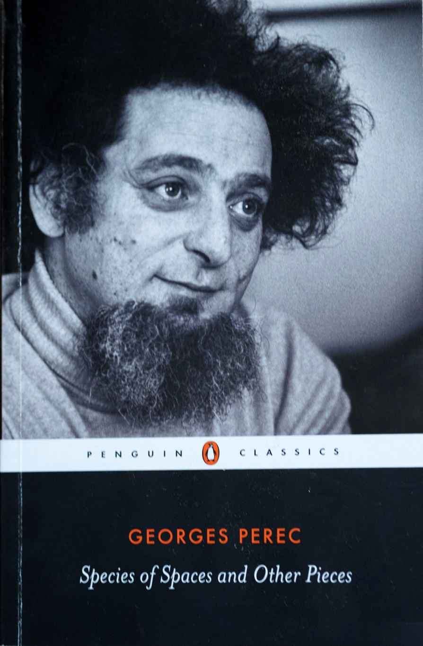
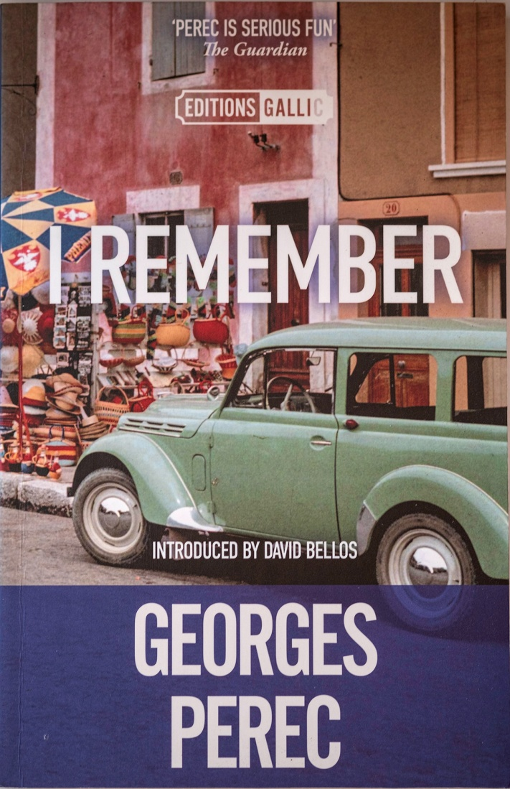
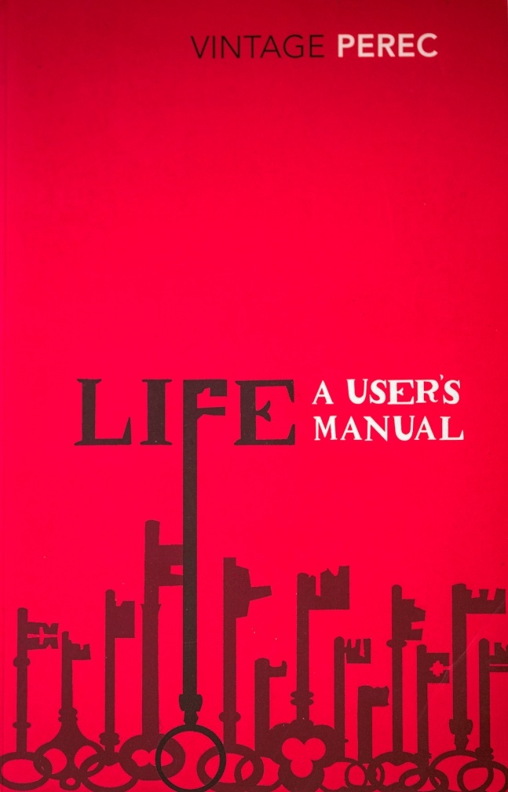
7. Georges Perec
Notes:
7. Georges Perec. I first heard of Georges Perec, a French-Polish, award-wining artist, on week 3 of this course and he speaks to me on many levels. Writing is his art and he has written on the need to observe, the everyday, the mundane, the infra-ordinary. Also he has written on the value of memories and on close communities.

Slide 8
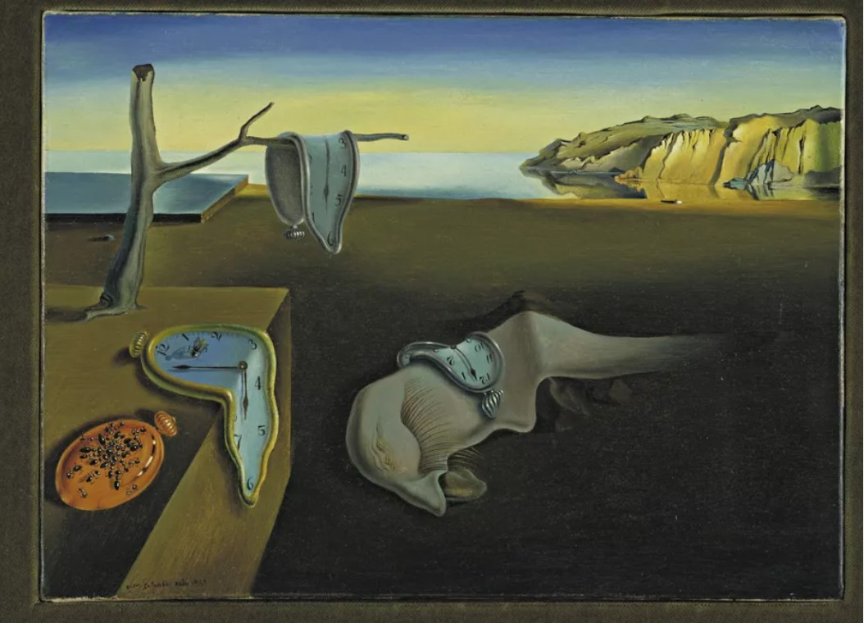
8. Dali, The Persistence of Memory
Notes:
8. Dali. The Persistence of Memory, Dali, 1931. The painting shows melted clocks and a featureless sea. This possibly refers to some of the scientific advances at the time. Described by the artist as being like Camembert melting in the sun, the watches depicted are thought to symbolize Einstein’s Theory of Relativity, concerning the distortion of time and space. The dreamlike beach scenery becomes a serene Surreal landscape, outside of the confines of time and space. Ref.: https://blog.artsper.com/en/get-inspired/10-famous-works-of-beach-art-from-throughout-art-history/

Slide 9
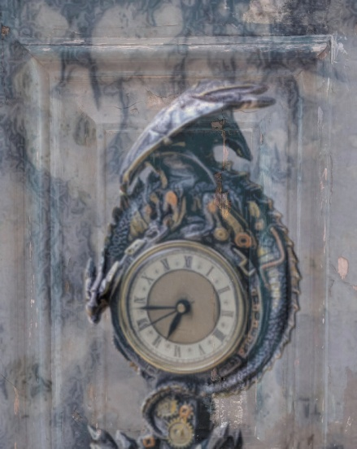
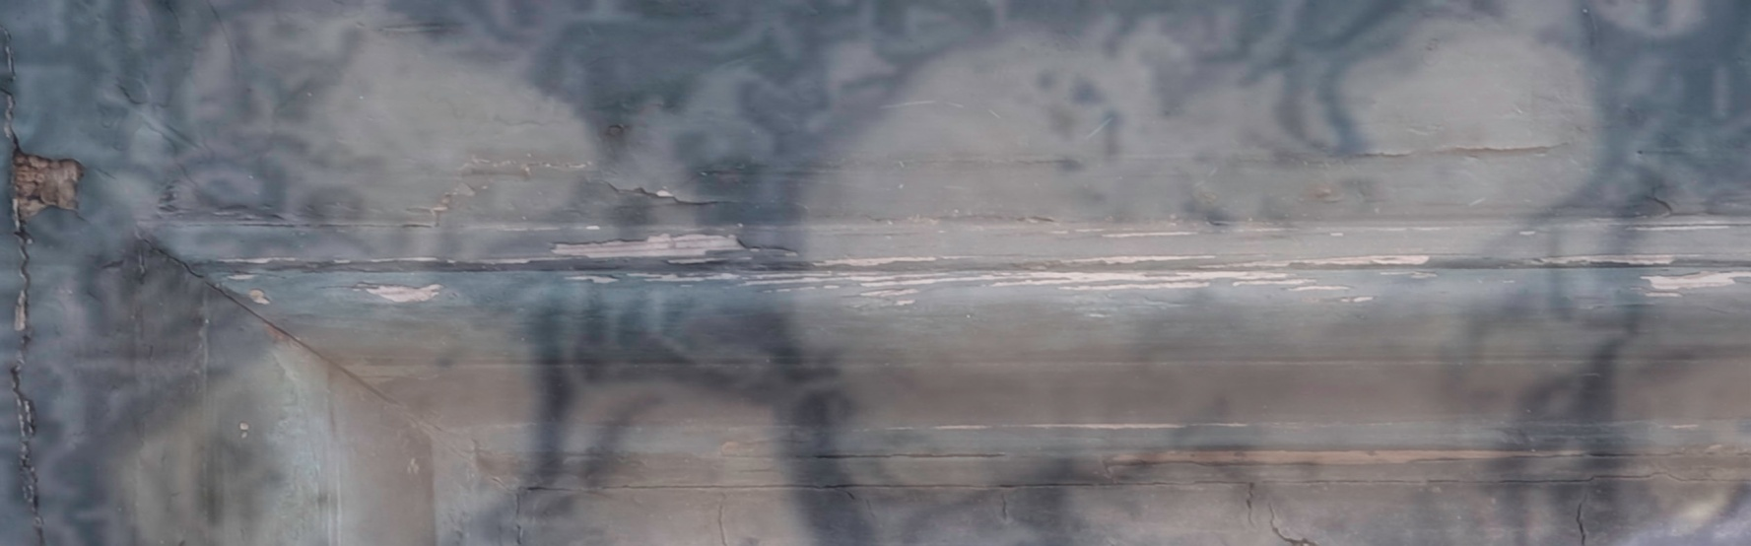

9. Time and Human Ageing
Notes:
9. Time and Human aging. I’m interested in another aspect of time and how humans start out with no past, very large (potential) future and lots of action in the present. At the end of our lives, memories are at the maximum, plans and actions are at a minimum.; and away from these extremes

Slide 10
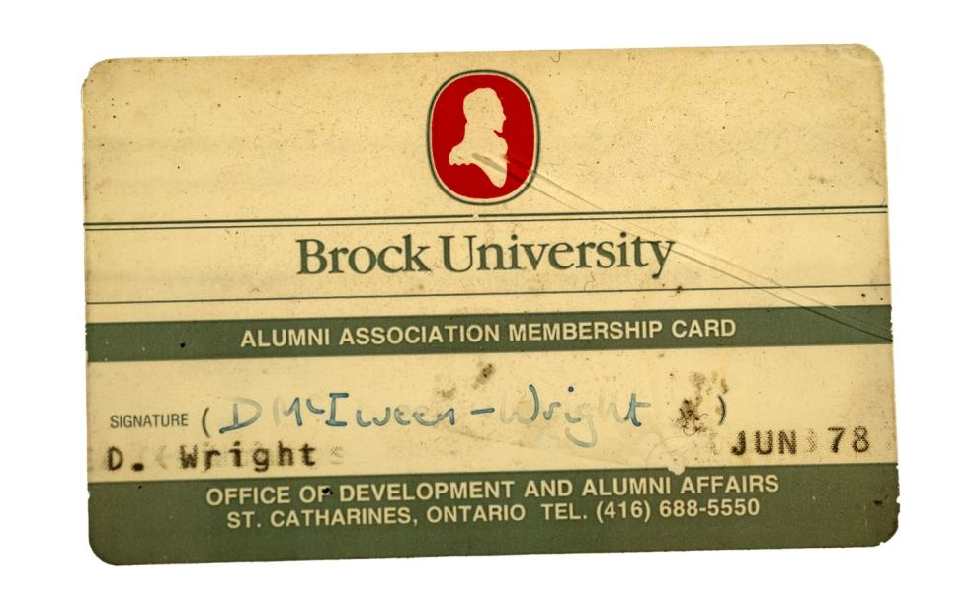
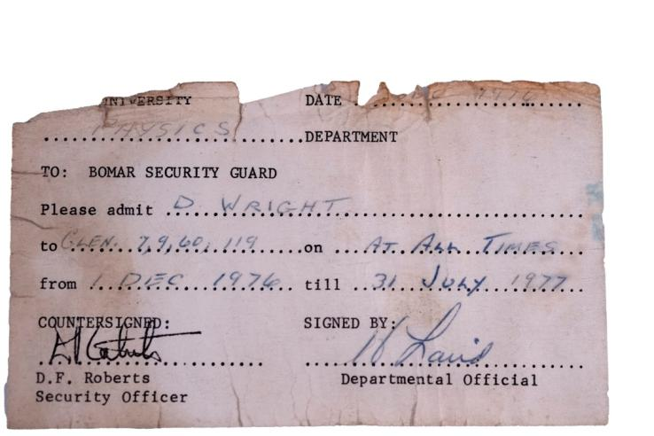
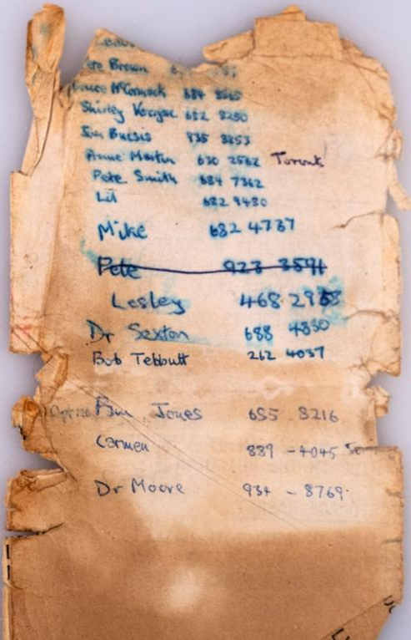
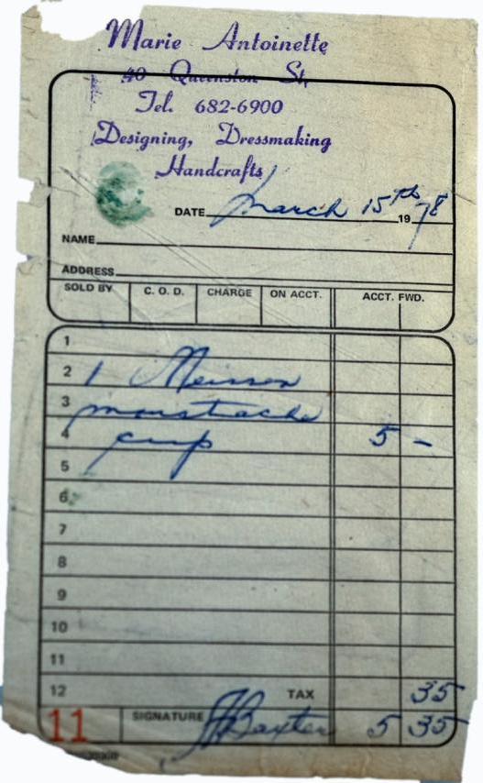
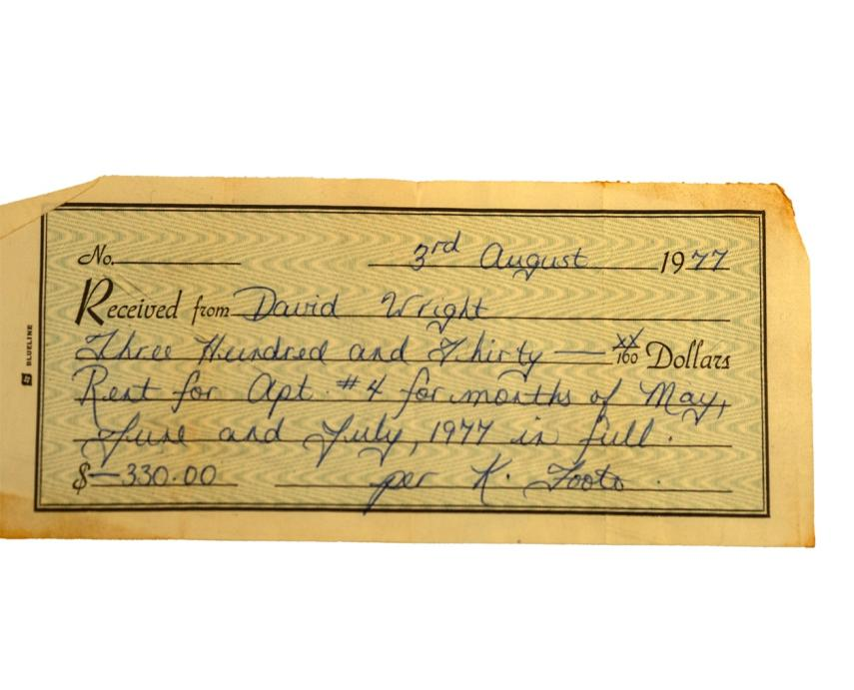
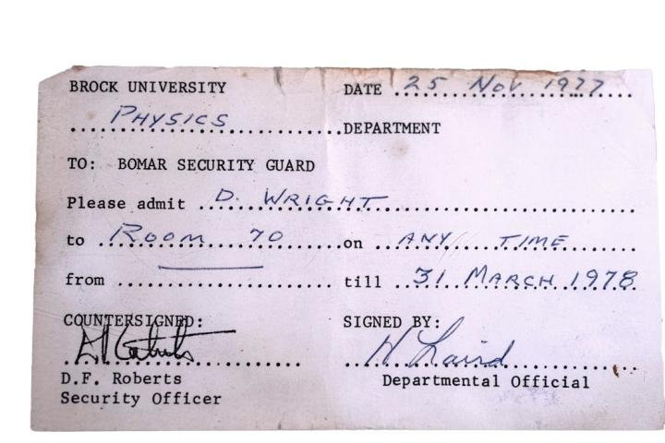
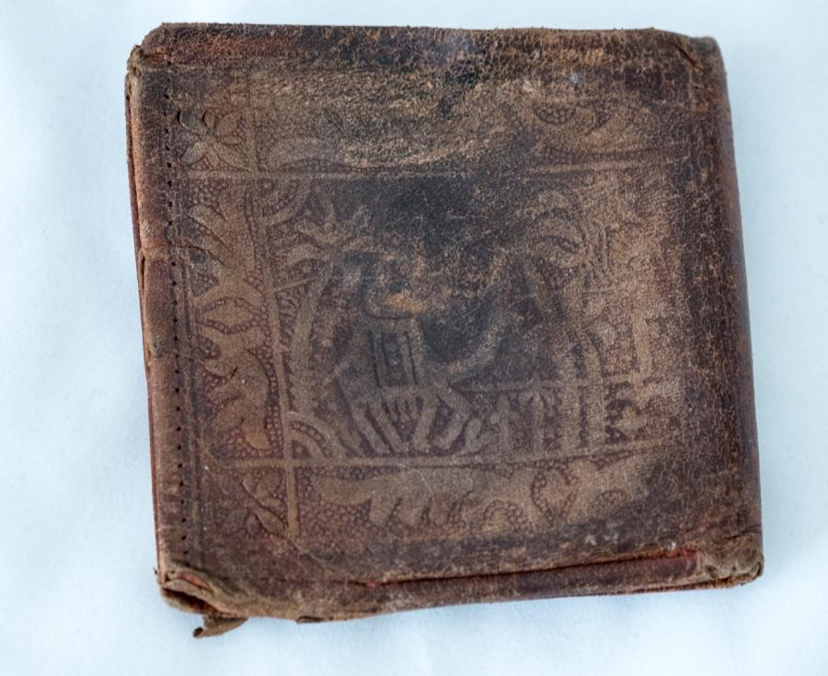
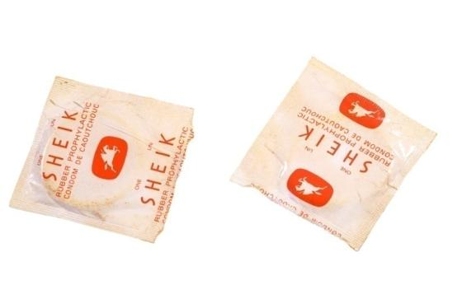
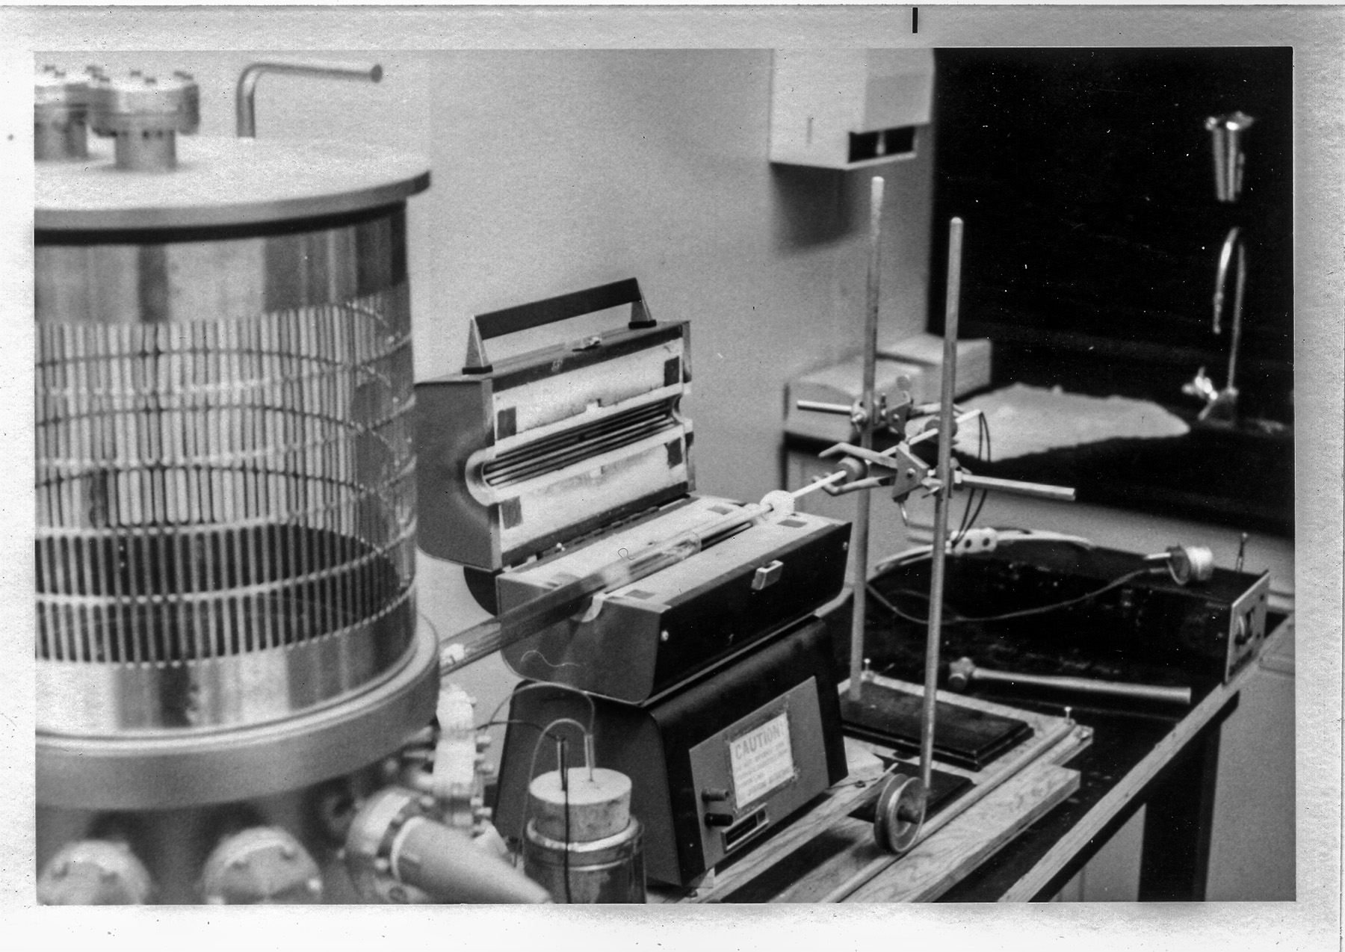
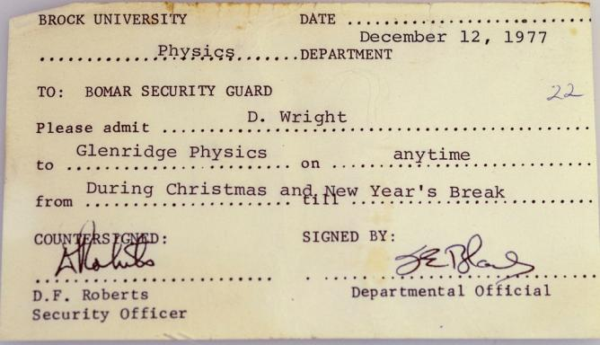
10. The wallet and Time.
Notes:
10. The wallet and Time. This wallet and its contents embody a slice of time for me, 1975 to 1978, in Canada doing my MSc in Physics at Brock university in St. Catharines. They are all mundane objects, ‘infra-ordinary’, as Perec would say, but merit closer attention. Each has its significance to me, recalling memories. The objects decay slowly with time and my memories alter as I age and develop.

Slide 11
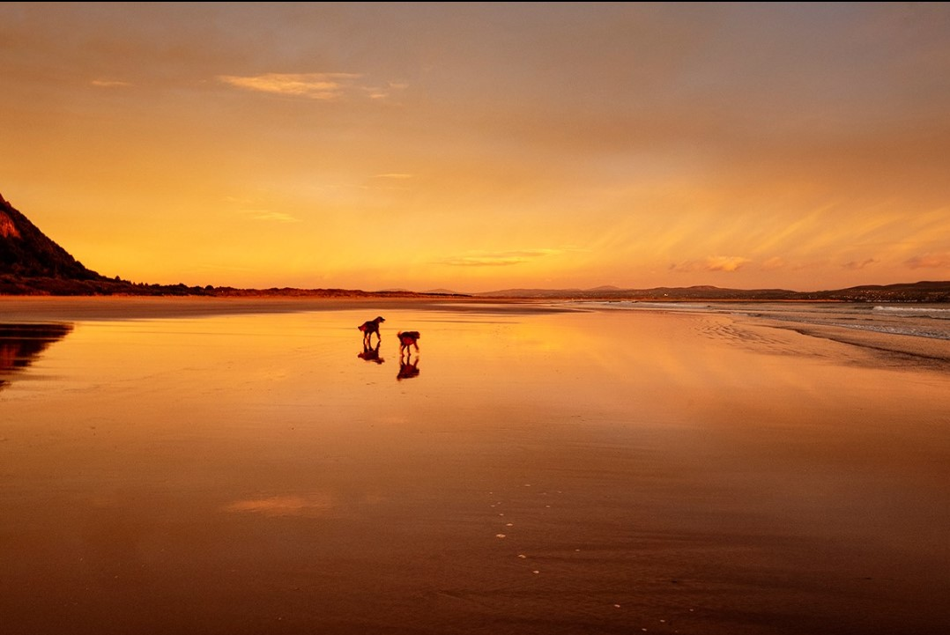
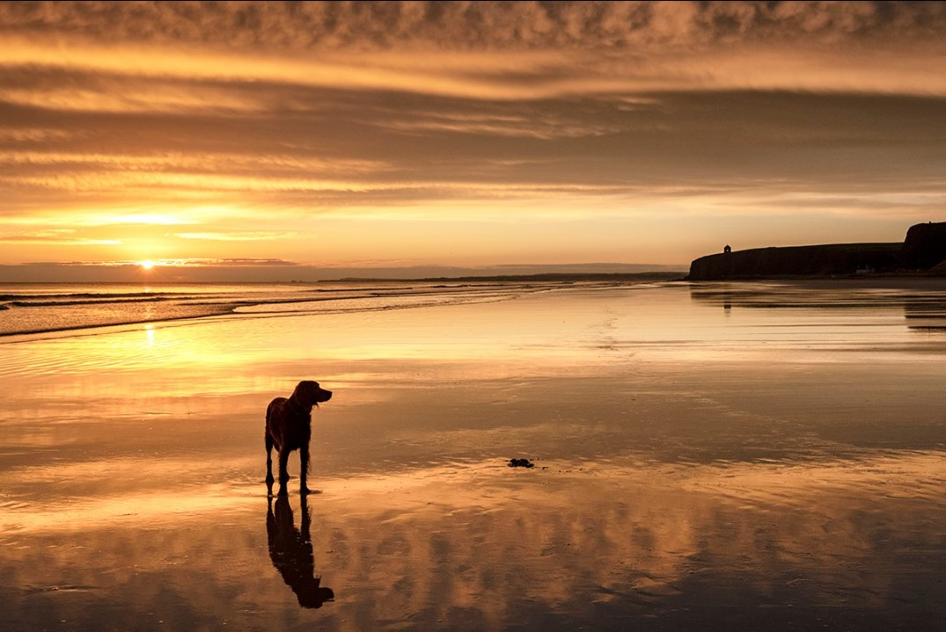
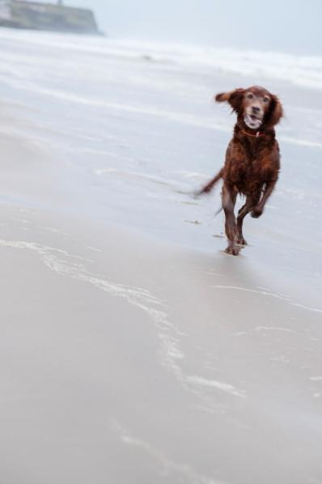
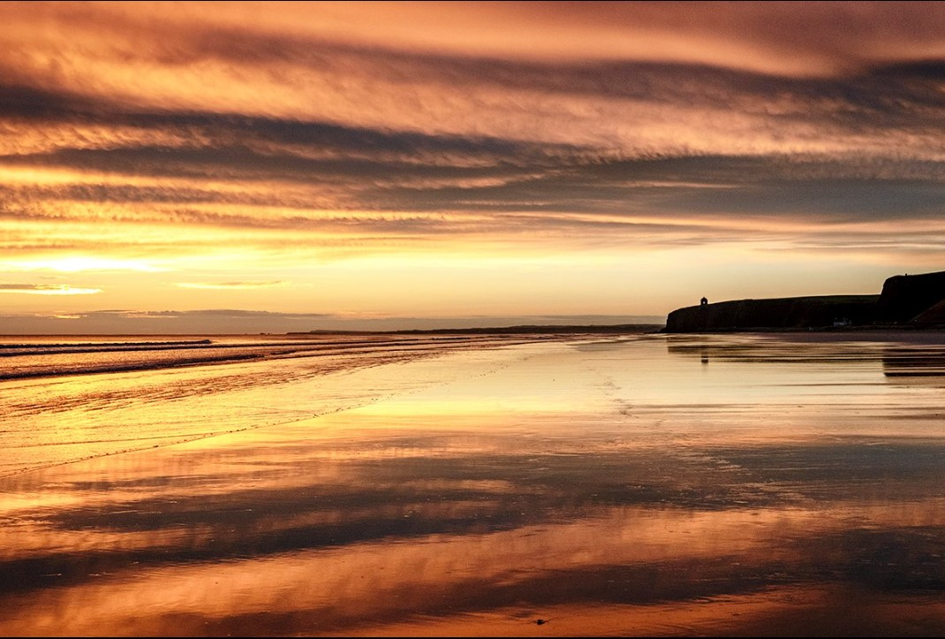
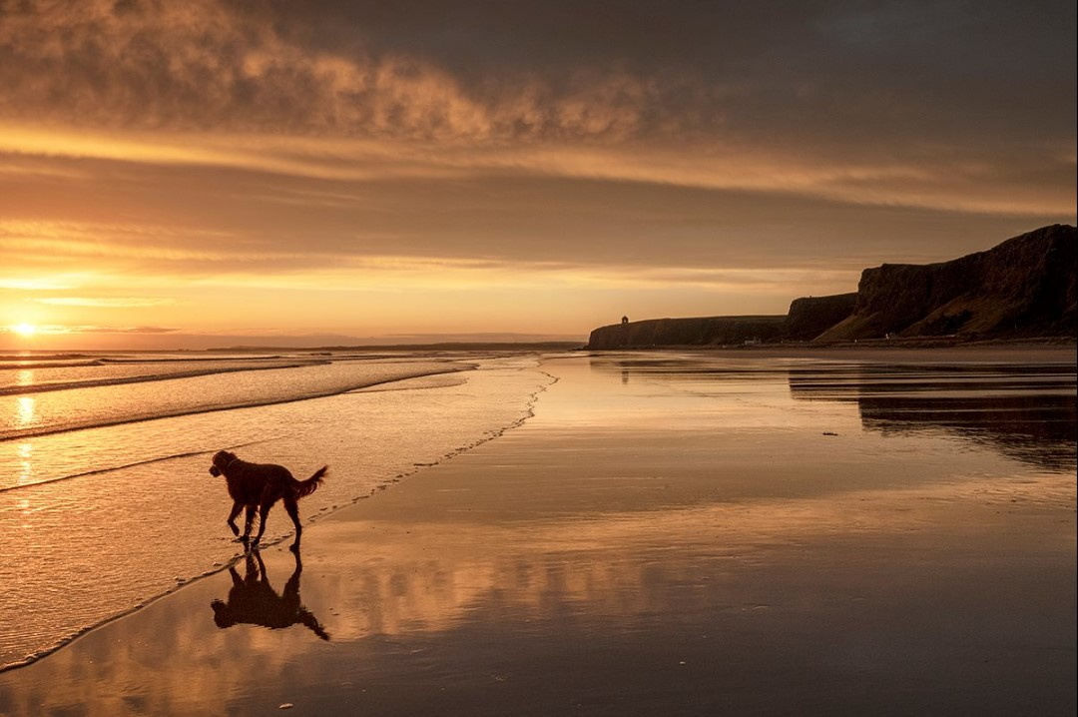
11. On the beach with the dogs
Notes:
11. On the beach with the dogs. When I go to the beach with the dogs, I see them enjoying the present time. For them, unlike me, there is no past and no future, just NOW. I am a bundle of memories and reflections; actions, external events and accidents; plans, hopes, regrets and dreams. My conscous mind seems to sync with the dogs for a while, and I relax. When I leave home for a photoshoot on the beach at sunrise with my dogs, my surroundings will be dark and quiet. As we near the beach, the dogs will know where we are and become excited. I’ll pick up on their anticipation.
On the beach I’ll be excited too. The light changes very quickly from darkness to pre-dawn, dawn and then sunrise. There may be reflections of the clouds on the wet sand. Often I will paddle. The movement of the sea depends on the phase of the tide and the wind speed. My dogs will chase any birds on the sand. All of these elements, light, sea, birds and dogs, are in constant flux and I enjoy trying to capture the essence of the dance. My senses are heightened, I’m in the moment, I’m happy.

Slide 12
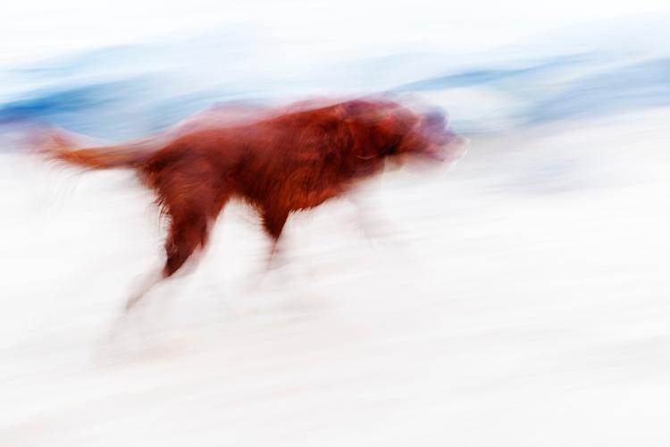
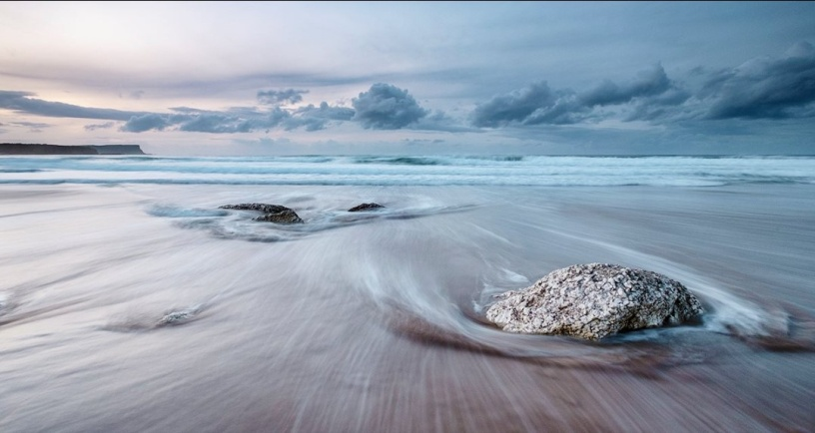
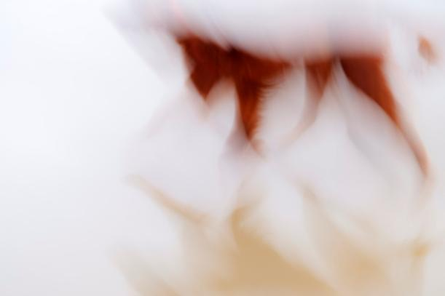
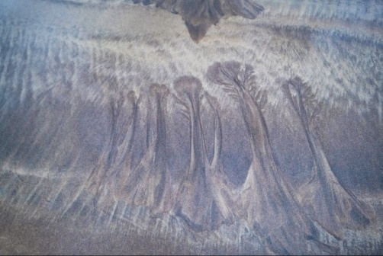
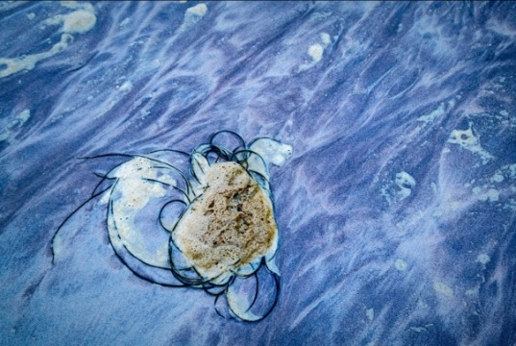
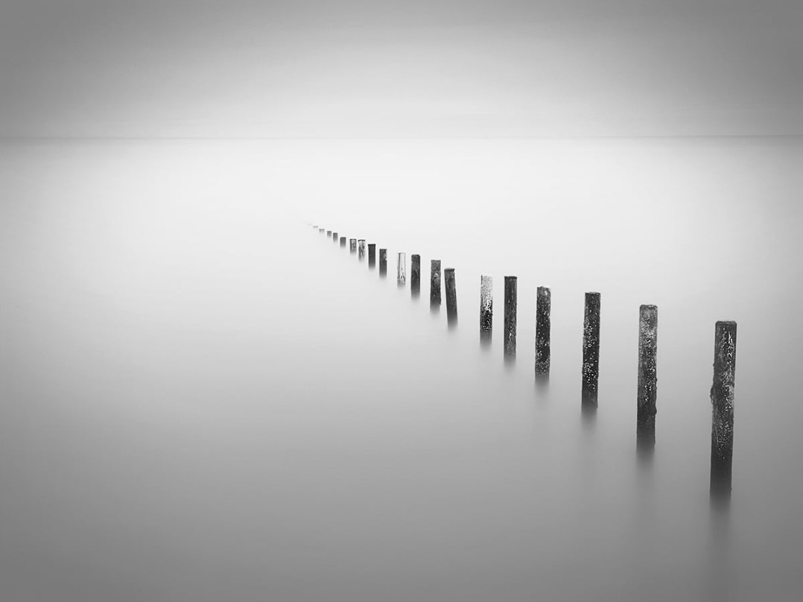
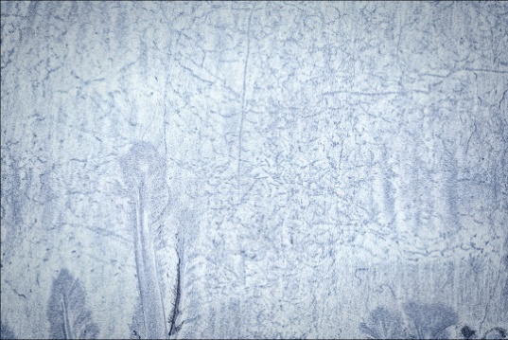
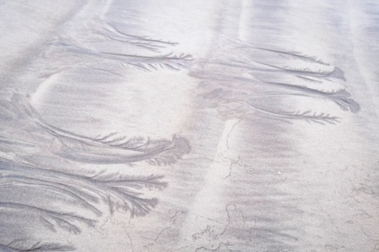
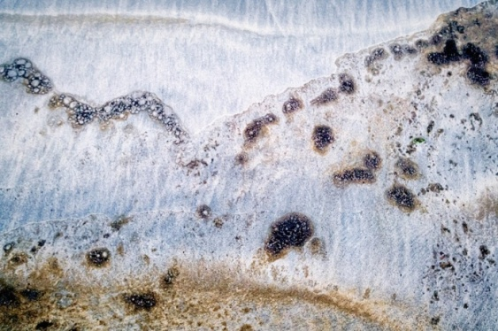
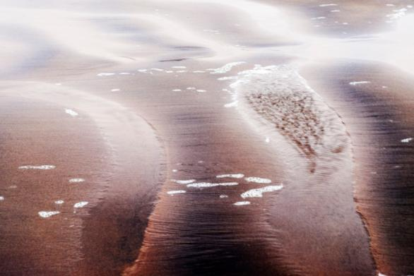
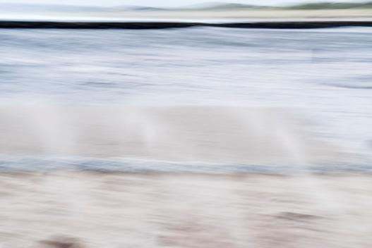
12. Beach and Time
Notes:
12. Beach and Time. So many factors on a beach that change with time can be investigated by photography. Times of day, such as sunrise, golden hour and night. Others, such as tides, water movements, waves, sand patterns and abstracts can also be captured.

Slide 13

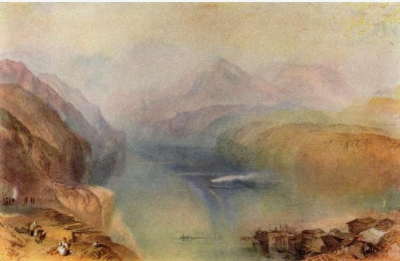
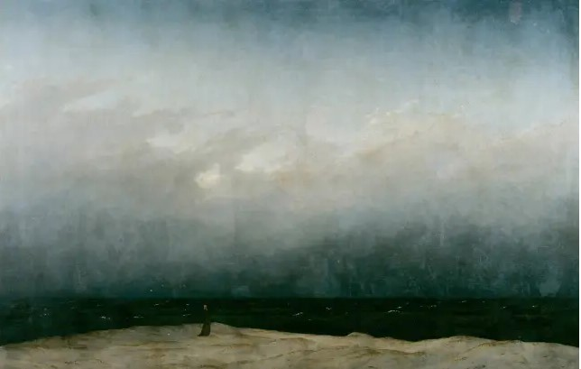
13. Context – how does it fit with the world of art?
Notes:
13. Context – how does it fit with the world of art? This work complies with that of Perec’s well-respected investigations of the infra-ordinary, of memories and changes with time. Art with a beach and time theme is well-known, for example Lake Lucerne by Turner in 1802, the Monk by the Sea by Caspar David Friedrich in 1808-10 and, off course, Dali’s Persistence of Memory, 1931.

Slide 14
14. Bibliography
Boltanski, Christian and Grenier, Catherine, The Possible Life of Christian Boltanski, Museum of Fine Arts, Boston, USA (2009).
Boltanski, Christian, and Moure, Gloria, Advent and Other Times, Edicioes Poligrafa, S.A., Barcelona. Spain, (1996).
Miller, Daniel, Stuff, Polity Press, UK and USA (2010).
https://iitcoa3rdyr.files.wordpress.com/2014/09/perec_readings.pdf
Perec, Georges, 'An Attempt at Exhausting a Place in Paris', Wakefield Press (2010), 1-49.
Perec, Georges, Species of Spaces and Other Pieces, Penguin Classics, London, UK , (1997).
Perec, Georges, I Remember, Gallic Books (1978).
Perec, Georges, Life, a User’s Manual, Vintage Books, London (2008).
Proust, Marcel, ‘A la recherche du temps perdu, The Folio Society, London (1992).
Smith, Keri, How to be an Explorer of the World, Perigree, New York (2008).
Smith, Keri, Everything is Conneccted, Particular Books, (2013).
Smith, Zadie, Feel Free, Penguin Books, UK (2018).
Notes:
14. Bibliography.

Slide 15
15. Future Work – Time and ...
Wallet
Science & Art
Beach
Notes:
15. Future Work – Time and ... I intend to pursue initially the effect of time on a found object, a location (the beach) and its interaction of science and art in the areas of entropy and quantum mechanics. I will probably home in on one or other of these themes as the arrow of time takes me forward.

